Slide 1
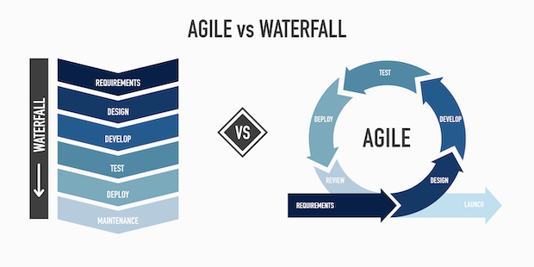
Agile Presentation
Hiroshi Thomas CS-250 Software Development Lifecycle Prof. Nathan Braun

Slide 2





Contents
Agile Roles
Product Owner
Stakeholders
Scrum Master
Development Team
Testers
Agile Phases
Inception
Iteration
Testing
Production
Review
Waterfall Model
Aspirations
New Initiatives
Key Metrics
Waterfall or Agile
Agile Flexibility
Vs.
Waterfall Stability
References
APA References

Slide 3
Agile Roles
Product Owner
Stakeholders
Scrum master
Development team
testers

Slide 4
Key Agile Roles
Product Owner
Stakeholders
Scrum Master
Development Team
Testers
Product Owner | Stakeholders | Scrum Master | Dev Team | Testers
Defines the product vision, manages the backlog, and ensures the development aligns with client expectations. | Stakeholders are parties with a vested interest or influence on the product. | Scrum Master embraces collaboration, leadership, and continuous improvement to help teams deliver value effectively. Scrum Masters are accountable for team effectiveness and facilitating Scrum practices. | Developers in a Scrum team are responsible for creating a usable Increment each Sprint, regardless of their specific product focus. Their key accountabilities include product development. | Testers take on the role of both a quality coach and a developer, guiding the team through every phase of the development lifecycle to ensure clear requirements and high-quality standards.

Slide 5

Agile Phases
Inception
Select Team
Establish Plan
Define Methods
Iteration
Work user stories / backlog
Build product with minimal features
Testing
Includes Unit, Integration, Acceptance, System
Production
Deliver dependable and efficient product that meets the customers requirements
Review
Once the product is launched the switch is made to continuous support and development

Slide 6

Waterfall Model
Waterfall Approach
Sequential phases where each phase must be completed before moving to the next (e.g., planning → design → development → testing → deployment).
In the SNHU Travel project, a change to the slideshow feature requested midway would have caused significant delays. Unlike Agile, where the change was incorporated in the next sprint, the Waterfall approach would require going back to the design phase, potentially derailing the timeline.
Impact on Development
Agile: Adaptability allowed the team to continue with high-priority tasks while the change was being refined.
Waterfall: Fixed phases mean less flexibility, which could have stalled progress.

Slide 7
Choosing Between Waterfall and Agile
Factors to consider:
Project Scope: If the scope is well-defined and unlikely to change, Waterfall might be suitable. However, for evolving projects, Agile provides flexibility.
Client Involvement: Agile encourages continuous collaboration and feedback, while Waterfall is better for projects where clients can provide all requirements upfront.
Development Speed: Agile’s iterative process leads to faster delivery of working software. In the SNHU Travel project, Agile allowed for continuous adjustments and early delivery of functional features.
Risk Management
Agile handles risks (e.g., scope changes, new features) more effectively due to its flexibility.
Waterfall struggles with mid-development changes, which could have complicated the slideshow update in the SNHU Travel project.

Slide 8

References
Scrum.org. (n.d.). Resources for growing as a Scrum Master. Scrum.org. https://www.scrum.org/resources/resources-growing-scrum-master
Scrum.org. (2020, March 3). The role of the professional tester in an agile world. Scrum.org. https://www.scrum.org/resources/blog/role-professional-tester-agile-world
Relevant Software. (2022, January 14). Agile software development lifecycle phases explained. Relevant Software. https://relevant.software/blog/agile-software-development-lifecycle-phases-explained/
Schwaber, K., & Sutherland, J. (2020). The Scrum guide: The definitive guide to Scrum: The rules of the game. Scrum.org. https://scrumguides.org/scrum-guide.html
Singh, V. (2022). The importance of daily Scrum meetings in Agile projects. Agile Alliance. https://www.agilealliance.org/glossary/daily-meeting/

